Slide 1
TASK-6 [Case Study]
Velpuri Mohit Sai Surya
AP22110010704
CSE-0

Slide 2
WHAT IS RECOMMENDER SYSTEM??
A recommendation system in machine learning is an application that suggests relevant items—such as products, movies, articles, or job postings—to users based on their preferences and behavior. By learning from past user interactions and item characteristics, recommendation systems help filter vast amounts of information, providing personalized suggestions. These systems are used in many online platforms like e-commerce websites, streaming services, social media, and job boards to improve user experience and engagement.
TYPES:
→Content based
→Collaborative filtering
→Hybrid Approaches

Slide 3

Job Recommendation System in Machine Learning
In today's competitive job market, finding the perfect job is a daunting task. Job recommendation systems, powered by machine learning, are revolutionizing the way we search for and apply to jobs. This case study explores the workings of these systems, highlighting their key components, benefits, and potential for improvement.

Slide 4

Machine Learning Algorithms for Recommendations
Collaborative Filtering
Content-Based Filtering
This approach uses past user behavior and ratings to recommend similar jobs based on the preferences of other users.
Recommendations are generated by comparing user profiles with job descriptions, focusing on relevant skills, experience, and interests.
Hybrid Models
Combining both collaborative and content-based filtering techniques to provide a more comprehensive and accurate recommendation experience.

Slide 5
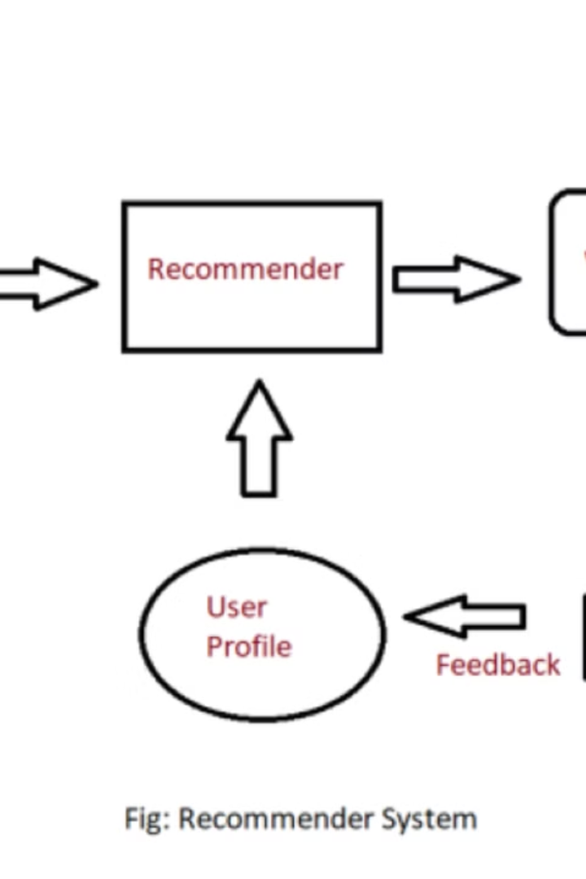
Introduction to Job Recommendation Systems
1
Personalized Recommendations
2
Improved Job Search Efficiency
Job recommendation systems leverage user profiles, job descriptions, and past interactions to generate tailored recommendations.
These systems streamline the job search process, filtering out irrelevant opportunities and presenting a curated selection.
3
Enhanced Matching Accuracy
Algorithms analyze vast amounts of data to identify jobs that closely align with user skills, experience, and preferences.

Slide 6
Data Collection and Preprocessing
User Data
Job Data
Preprocessing
This includes information about skills, experience, education, career goals, and job search history.
Job descriptions are parsed and analyzed for relevant information, such as job title, company, location, and responsibilities.
Data cleaning and transformation are essential to ensure data quality and consistency for accurate analysis.
Skills
Experience
Job Title
Data Cleaning
Education
Company
Feature Engineering
Location

Slide 7




Feature Engineering and Selection
Feature Extraction
New features are derived from existing data to represent relevant information more effectively.
Feature Selection
Identifying and choosing the most relevant features for the recommendation model is crucial for accuracy and performance.
Feature Scaling
Scaling features to a common range helps improve the performance of machine learning algorithms.

Slide 8
Evaluation Metrics and Methodology
Metric
Description
Precision
The proportion of recommended jobs that are relevant to the user.
Recall
The proportion of relevant jobs that are recommended to the user.
F1-Score
A harmonic mean of precision and recall, balancing both measures.

Slide 9
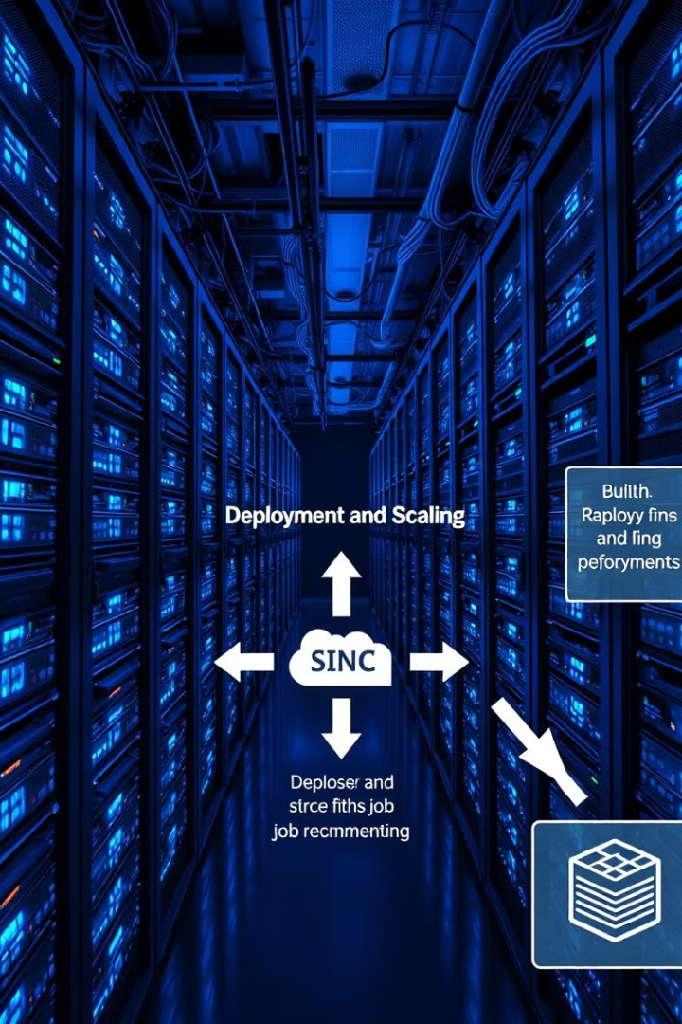
Deployment and Scalability Considerations
1
Cloud Deployment
Leveraging cloud computing platforms for scalability, flexibility, and cost-effectiveness.
2
Microservices Architecture
Breaking down the system into smaller, independent services for improved modularity and scalability.
3
Real-Time Data Processing
Handling incoming data streams and updating recommendations in real time for a dynamic user experience.

Slide 10




Conclusion and Future Improvements
Personalized User Experiences
Continuously refining algorithms to provide tailored recommendations based on individual preferences and career goals.
Enhanced Data Integration
Integrating data from diverse sources, including social media, professional networks, and online learning platforms.
Advanced Machine Learning Techniques
Exploring emerging machine learning techniques, such as deep learning and natural language processing, to improve recommendation accuracy and relevance.

Slide 11
Thank You
I hope this case study has provided valuable insights into the workings and potential of job recommendation systems.

